Slide 1
Understanding the S&P MidCap 400
F427: ML & AI in Investing

Slide 2


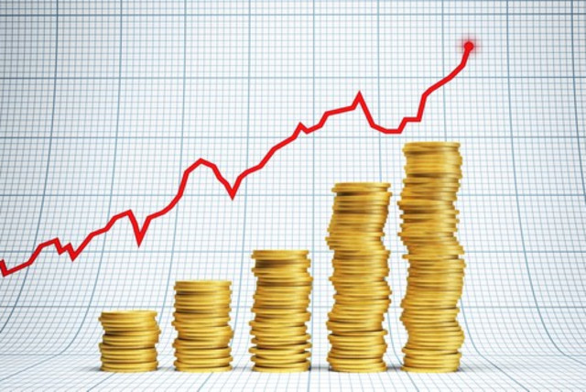
What is this class about?
2
Machine Learning
Computer algorithms that can improve automatically through experience and the use of data
Artificial Intelligence
Having computer systems perform tasks that normally require human intelligence
Investing
Expending money with the expectation of earning a profit or material result

Slide 3

Supervised Machine Learning
Supervised Learning: use labeled datasets to make predictions about similar labeled datasets
Labeled data: data where the structure and variables are known
Regression analysis: predicting default
Classification: separating spam from useful email

Slide 4
Unsupervised Machine Learning
Generate predictions for unlabeled datasets
Unlabeled data: Data where structure and variables are unknown
Clustering: breaking data into smaller groups of similar objects – image compression
Association: “customers who bought this item also bought …”
Dimensionality reduction

Slide 5
Which type of learning in investing?
In active investing, our goal is to predict which stocks will perform better than others
Supervised learning: associate known data with known outcomes in order to make future predictions
Goal: predict robust outcomes
Unsupervised learning: create associations among groups of unknown data without outcome variables
Goal: understand data structure

Slide 6
Our task
Our objective is to use machine learning to identify factors that appear to explain returns on stocks in the S&P MidCap 400 index, and use this analysis to make recommendations on stocks to construct a hypothetical investment fund.
For example, we know that small market capitalization stocks and stocks with a high book value of equity compared to market value (sometimes referred to as "value stocks") have historically earned higher returns than large market capitalization stocks and stocks with a low book value of equity compared to market value (sometimes referred to as "growth stocks"). So one example would be to use machine learning techniques to test the relationship between a company's market capitalization, its book-to-market ratio, and past returns, and make a recommendation on whether we should put a stock in the portfolio on the basis of its value versus growth characteristics.
That is just one example. Over the course we will investigate other factors that rely upon analyst earnings forecasts, industry classification, companies' past investments, and companies' historical profitability. Students will work in groups to perform analysis and ultimately make portfolio recommendatio
6

Slide 7
The road ahead
Topic | Quantitative technique
Understanding the S&P MidCap 400 | Compilation of cumulative returns
Defining our performance objective: Alpha versus a passive investment in the benchmark | Ordinary Least Squares (OLS) regression
Stock characteristics that are plausibly indicators of alpha (signals): value, quality, smart money, momentum
Overfitting and testing results out of sample
Introduction to machine learning
Overfitting and penalized regression | Least absolute shrinkage & selection operator (LASSO) regression
Non-linearity in the relationship between signals and returns | Decision trees: Basic
Non-linearity in the relationship between signals and returns, combined with over-fitting | Decision trees: Random forests
Non-linearity in the relationship between signals and returns, combined with over-fitting | Decision trees: Gradient boosting
Sophisticated identification of relationships between signals and returns | Neural networks
Comparison of machine learning techniques

Slide 8
What to deliver
3 reports (5 pages) and presentations
Stock recommendation within a FactSet Economic Sector
Each report will build off the prior report, even though it is a new stock recommendation
New features you believe are predictive of returns
New estimation techniques
Changes to parameter inputs
Teams
About 4 students per team
Team formation a mixture of student input and my selection
Different skill sets
Code
We will write code to underpin the analysis
But your code is not assessed
What is assessed?
Your written work and presentation, with particular emphasis on
Economic rationale
Ability to convey meaning
Identifying a relationship between X and Y without rationale is probability association without causation

Slide 9
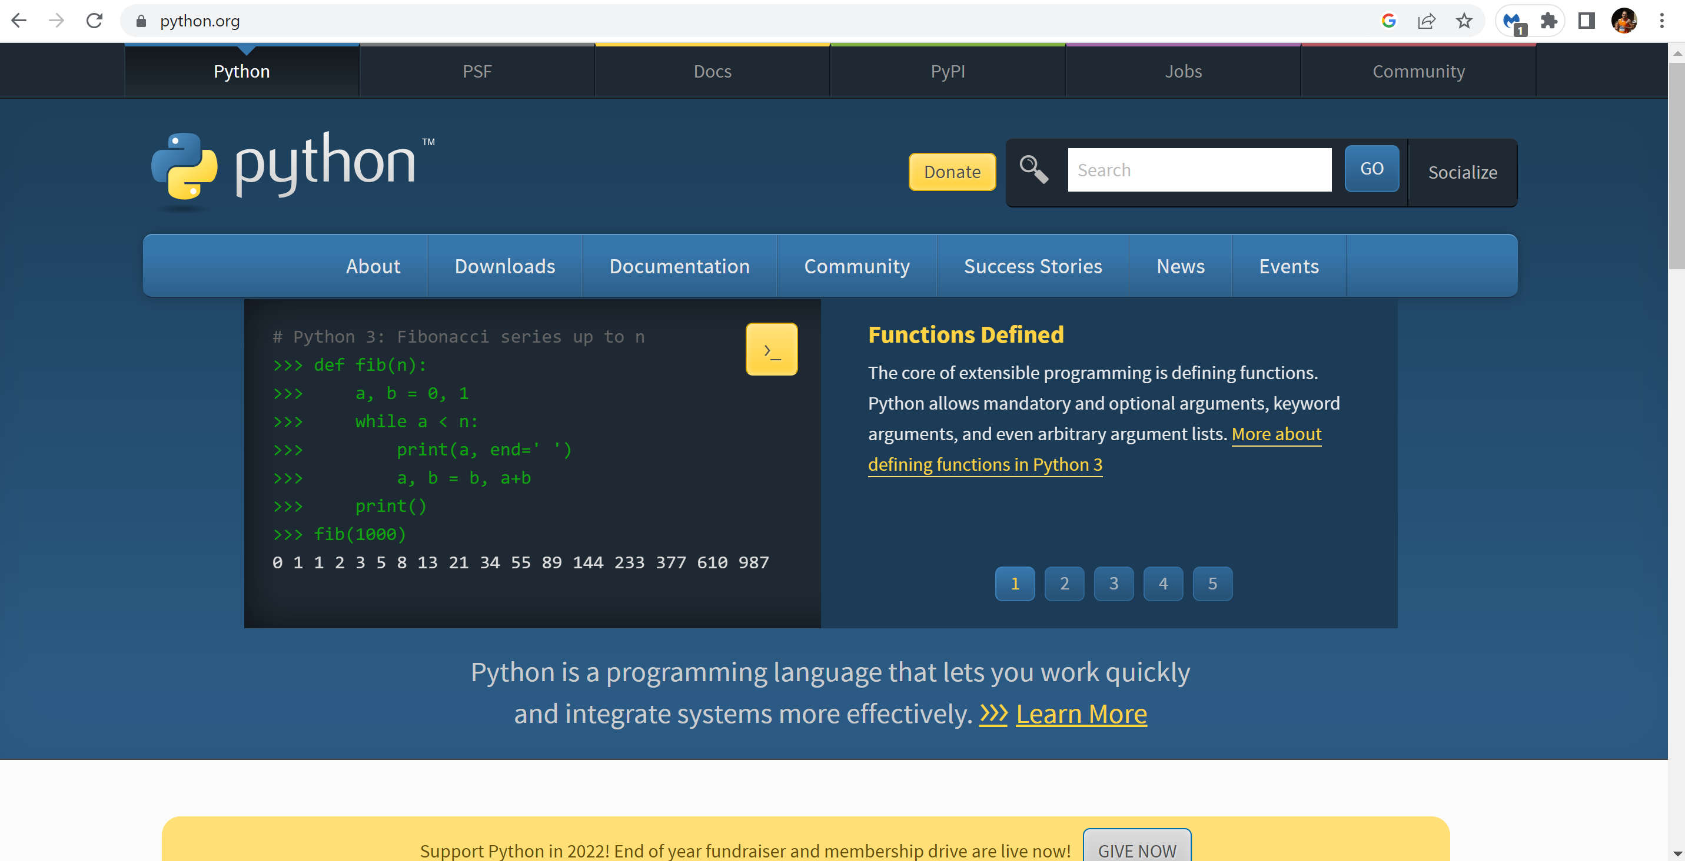
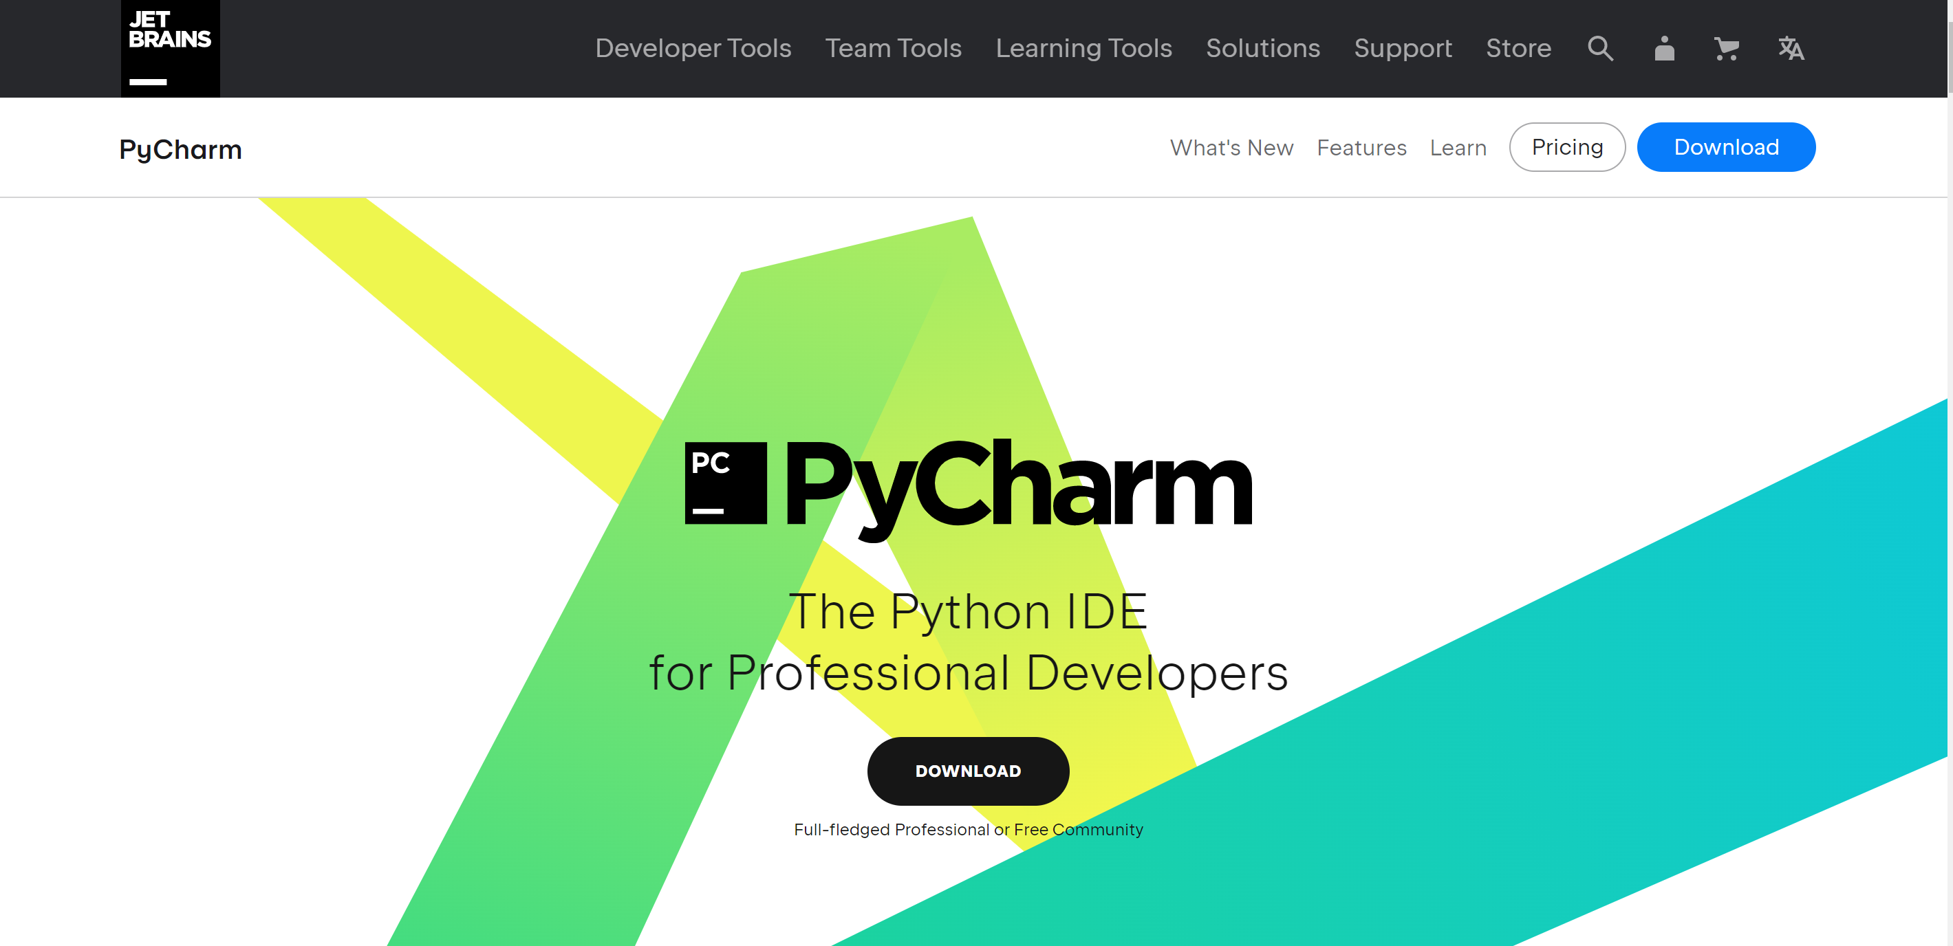
Python (1)
Installation
https://www.python.org/
Developer tool
https://www.jetbrains.com/pycharm/

Slide 10
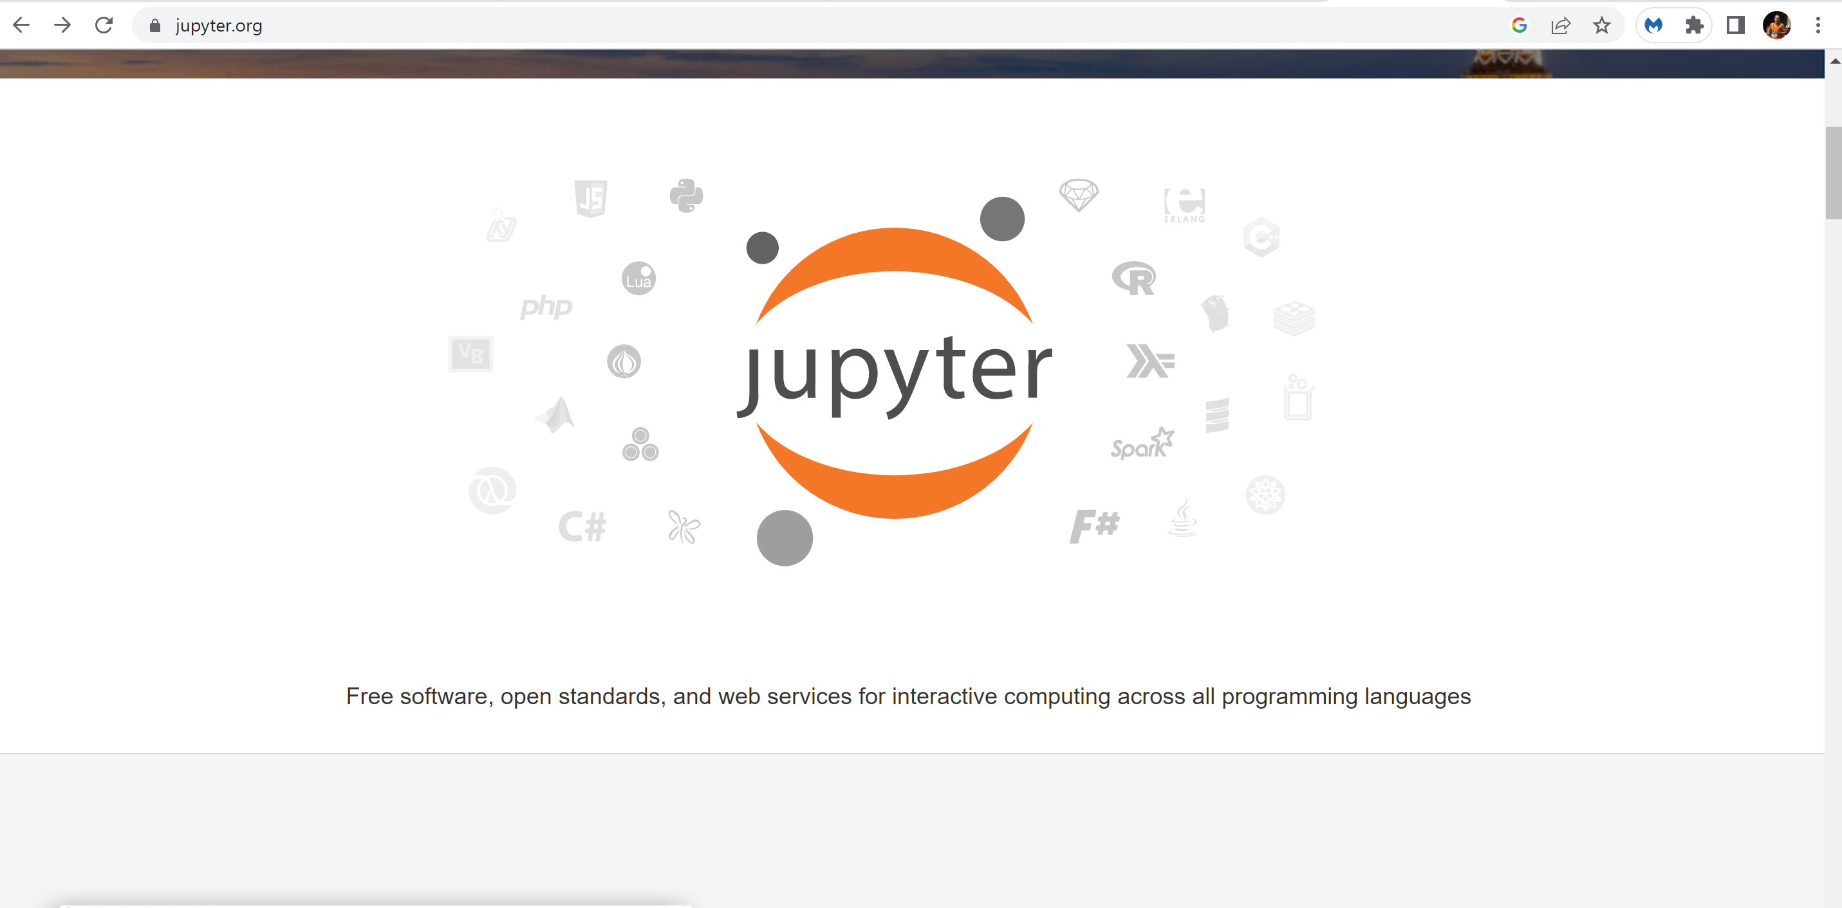
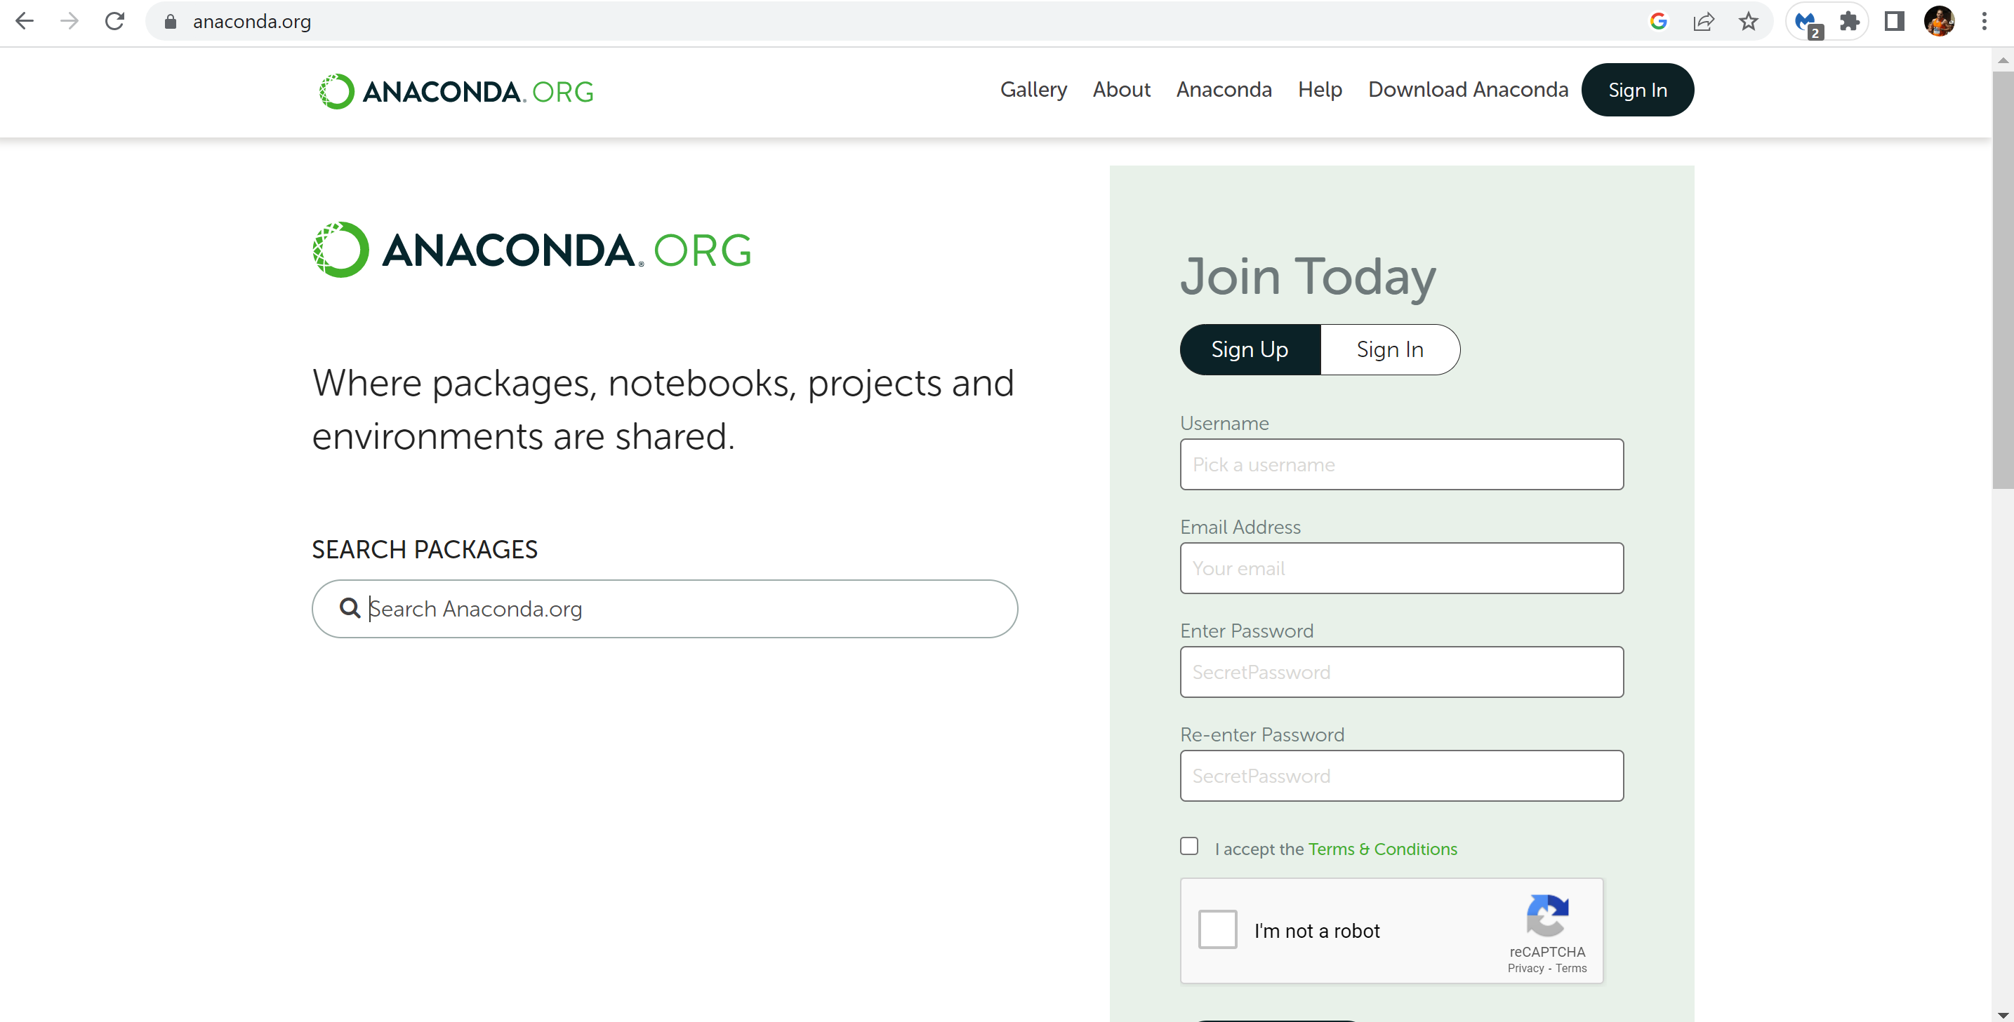
Python (2)
Jupyter Notebook – a useful tool for sharing code
https://jupyter.org/
I downloaded Anaconda and then installed Jupyter Notebook from there
https://anaconda.org/

